Slide 1
Unemployment Trends by Age and Gender (2005–2015)
MSDS 670 – Data Visualization
Maryi Tatiana Palacios Giraldo
Week 4

Slide 2
OBJECTIVE
The goal of this analysis is to understand how unemployment evolves across different age groups and genders over time, and to identify which populations are most affected and when.

Slide 3
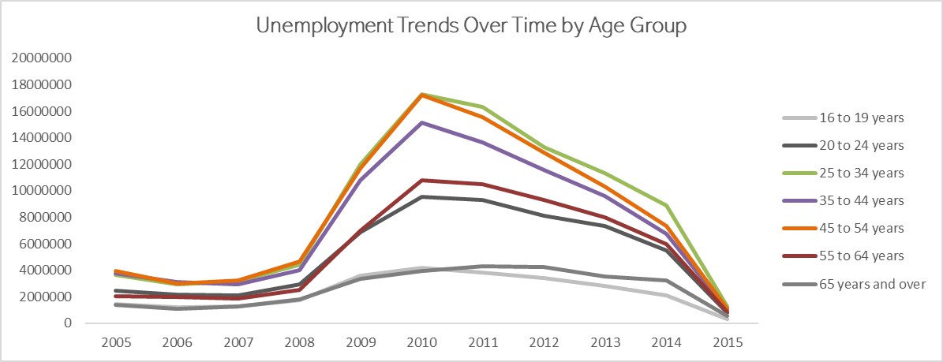
Unemployment Trends over time by age group
All age groups follow the same economic cycle.
Ages 25–54 show the largest fluctuations over time.
Younger and older groups change less, showing greater stability.

Slide 4
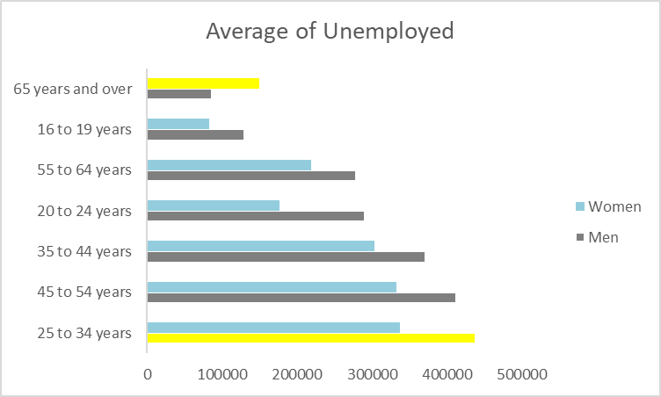
Average Unemployment by Age
Group and Gender
Men have higher unemployment than women in most age groups.
The 25–34 age group has the highest unemployment among men, despite being a highly productive age.
The lowest unemployment appears among women 16–19 and men 65 and over.

Slide 5
Unemployment Intensity by Age Group and Period
Overall, unemployment remained relatively stable from 2005 to 2008.
The largest increases occurred between 2009 and 2013, with a peak in 2010.
Data for 2015 only includes January and February, but the trend appears to stabilize again.

Slide 6
Conclusions
Ages 25–54 are the most exposed to economic changes, showing both the highest unemployment levels and the strongest fluctuations over time.
The highest unemployment among men occurs at ages 25–34, a stage often considered highly productive, particularly for men, which highlights unexpected economic vulnerability in this age group.
Gender gaps in unemployment are consistent across most age groups, with men generally experiencing higher unemployment than women, except in the 65 and over category.

Slide 7

Thank you

